Slide 1
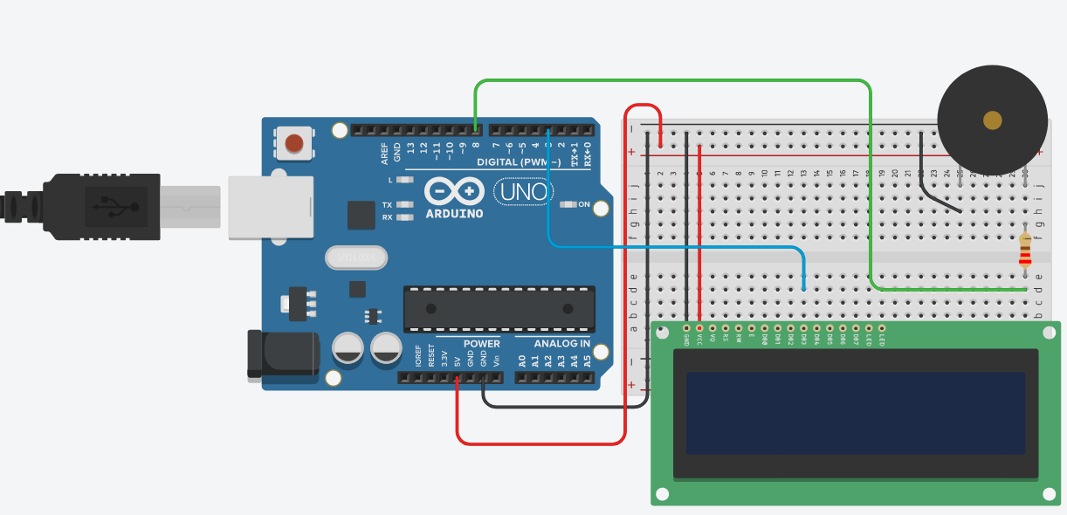
CS341 Lab 5:
LCD display and piezoelectric speaker
https://github.com/whittyh/CS341

Slide 2
Lab 5 Objectives:
Connect some interesting hardware to the Arduino to further explore interfacing I/O
Write a circular buffer to implement a ticker screen with a message
Beep the piezoelectric speaker on an interval
Use a potentiometer to control the contrast of the panel by changing resistance of the contrast pin

Slide 3
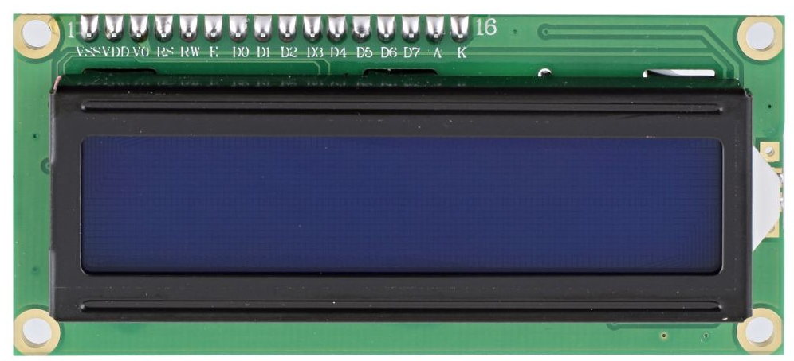
Programming the LCD:
<SoftwareSerial.h>
// already in setup:
serial_display.begin(9600); // setup port at 9600bps
serial_display.write(0x0c); // ASCII Form Feed - clear display
delay(10); // delay required
// already in loop:
serial_display.write(0x9b); // set cursor to line 1 pos serial_display.write(itoa(time, timeblock, 10)); // convert time to ascii for print
serial_display.write(); // enter char array (string in c) to output
// to screen at cursor location

Slide 4
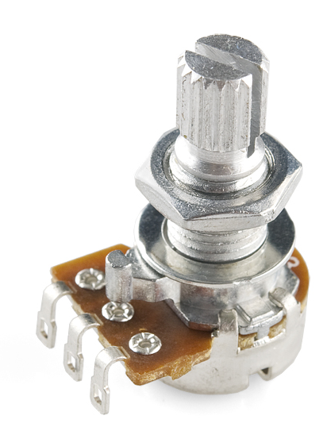
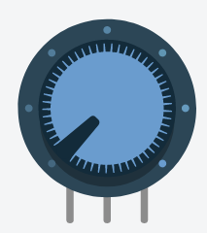
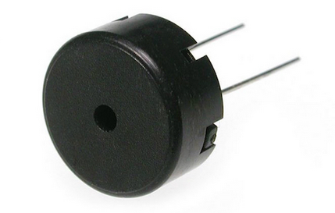

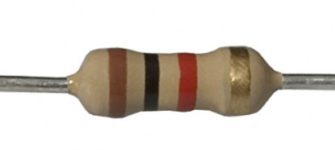
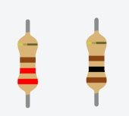
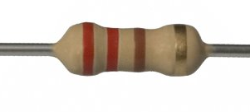
Hardware:
Potentiometer:
Varies resistance
Piezoelectric Speaker:
// 1500 Hz tone:
tone(buzzer, 1500);
// turn off buzzer:
noTone(buzzer);
Resistors:

Slide 5
Steps:
Complete the circuit:
test by using the starter code before step 2
Implement a circular buffer:
“Welcome CS341 Students! ” // First display this
“elcome CS341 Students! W”. // Then this…
“lcome CS341 Students! We” // and so on…
Tail
Head

